Slide 1
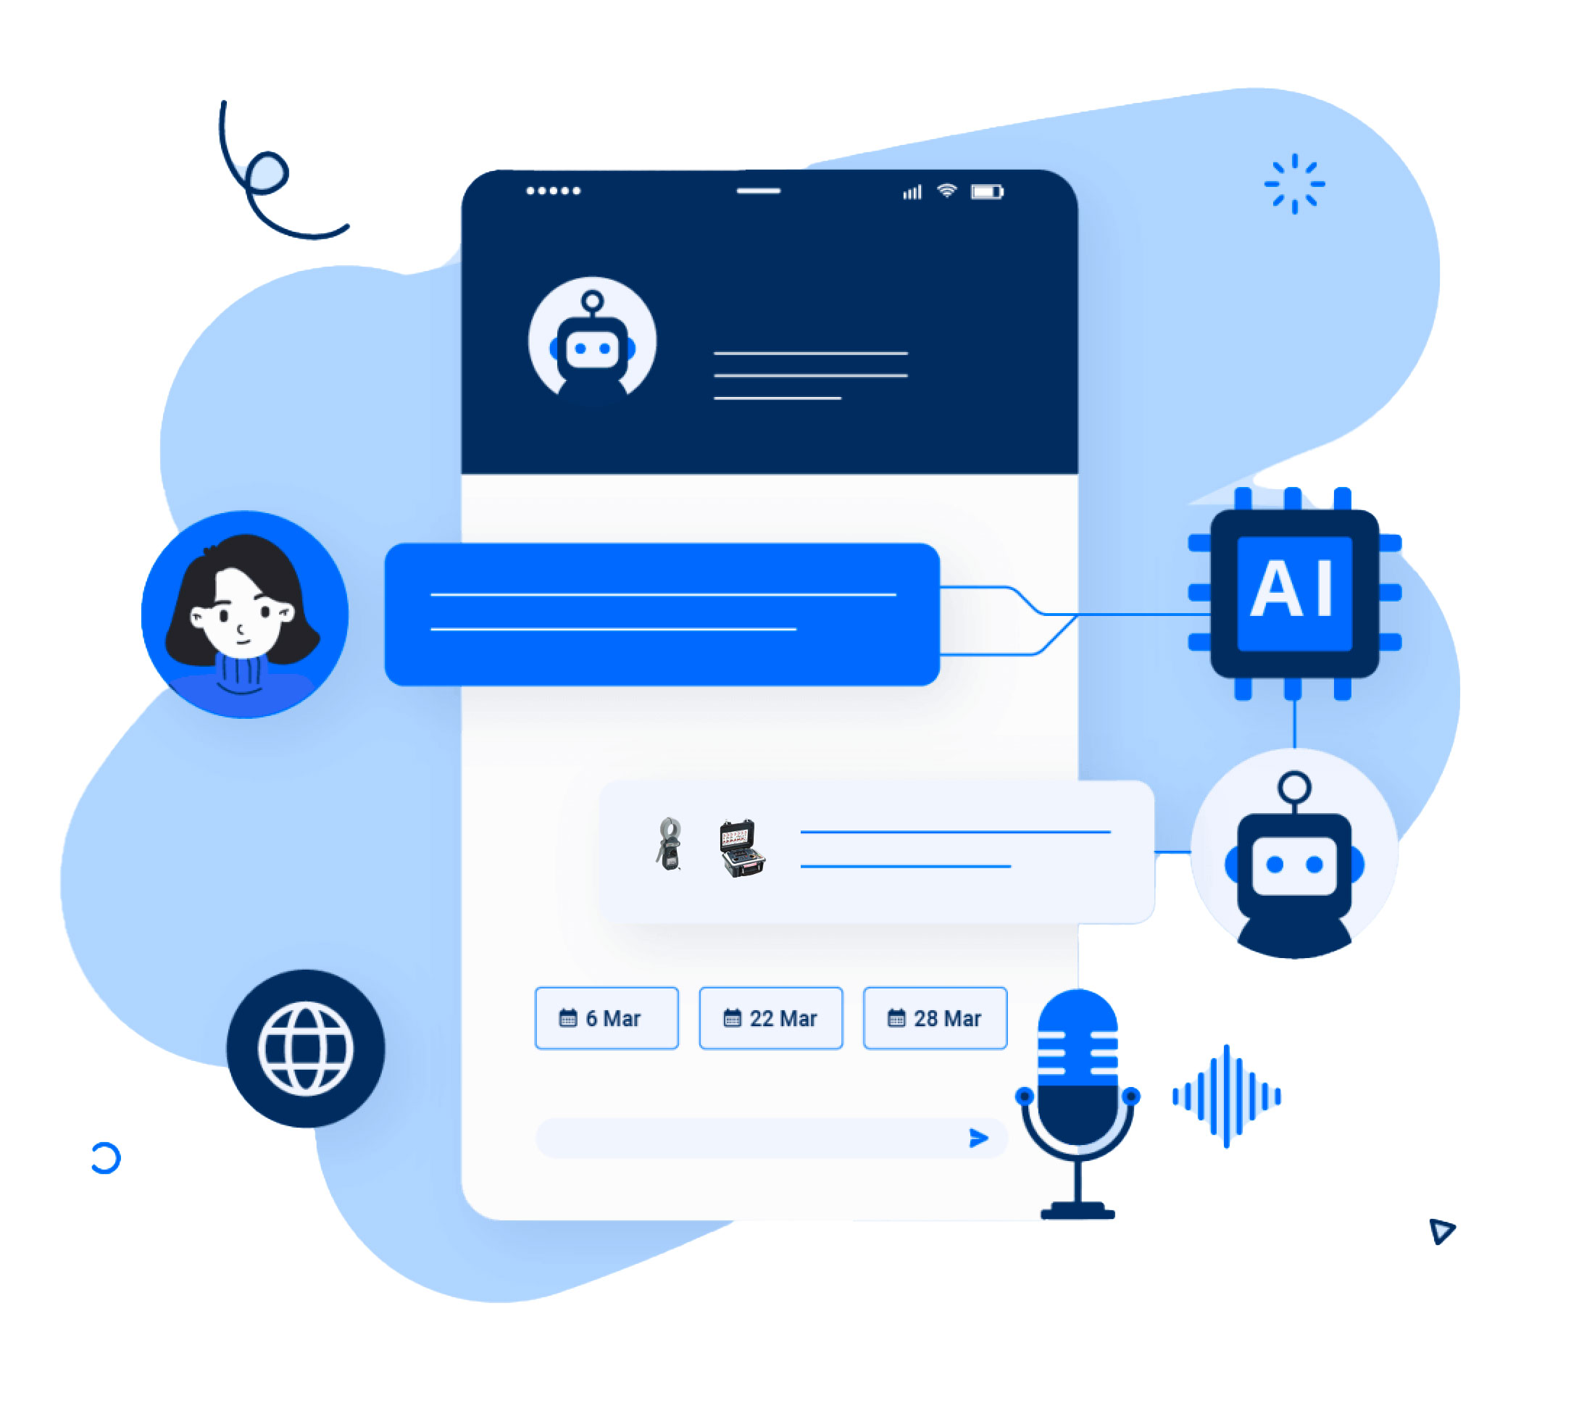
Enhancing PPC Landings
ChatGPT 3.5+ Powered Chatbots
Introduction to Chatbot Integration
Benefits
Possible uses
Case Study
Hi I’m Megger Assistant

Slide 2
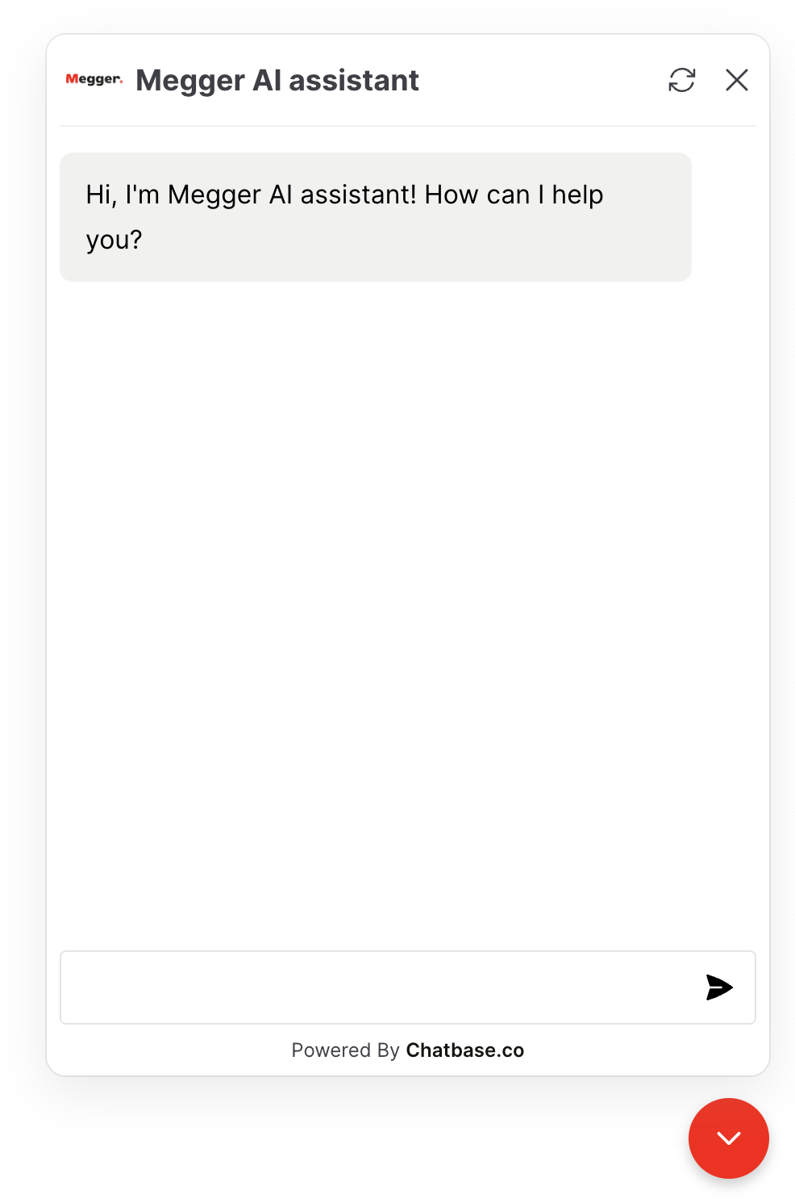
Benefits for User Engagement
Instant response to user inquiries, keeping them engaged
Personalized interaction, which can guide users through the landing page content
Availability 24/7 to interact with users at any time, reducing bounce rates
Translated into multiple languages: you can ask in many languages, and it will reply in the same language you ask

Slide 3
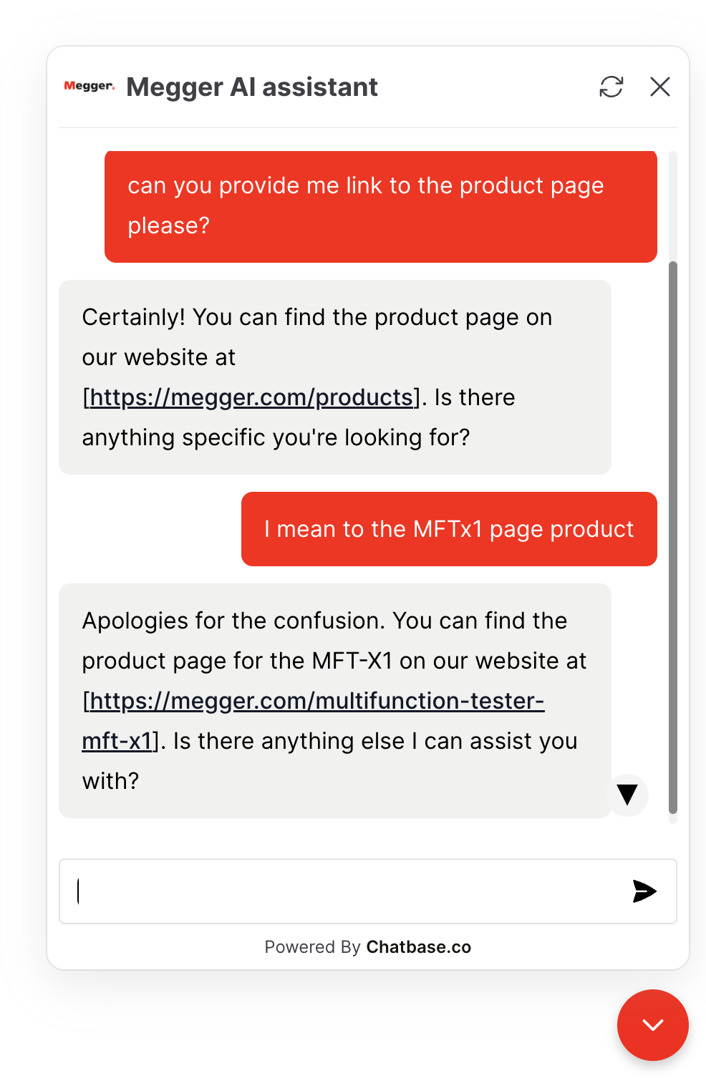
Boosting Conversion Rates
Chatbots can answer product or service-related questions in real-time, reducing barriers to conversion
The ability to direct users to specific calls to action (CTA) based on their queries
Gathering user data and feedback to improve the PPC campaign’s targeting and messaging
Interactive Chatbot Assistance

Slide 4
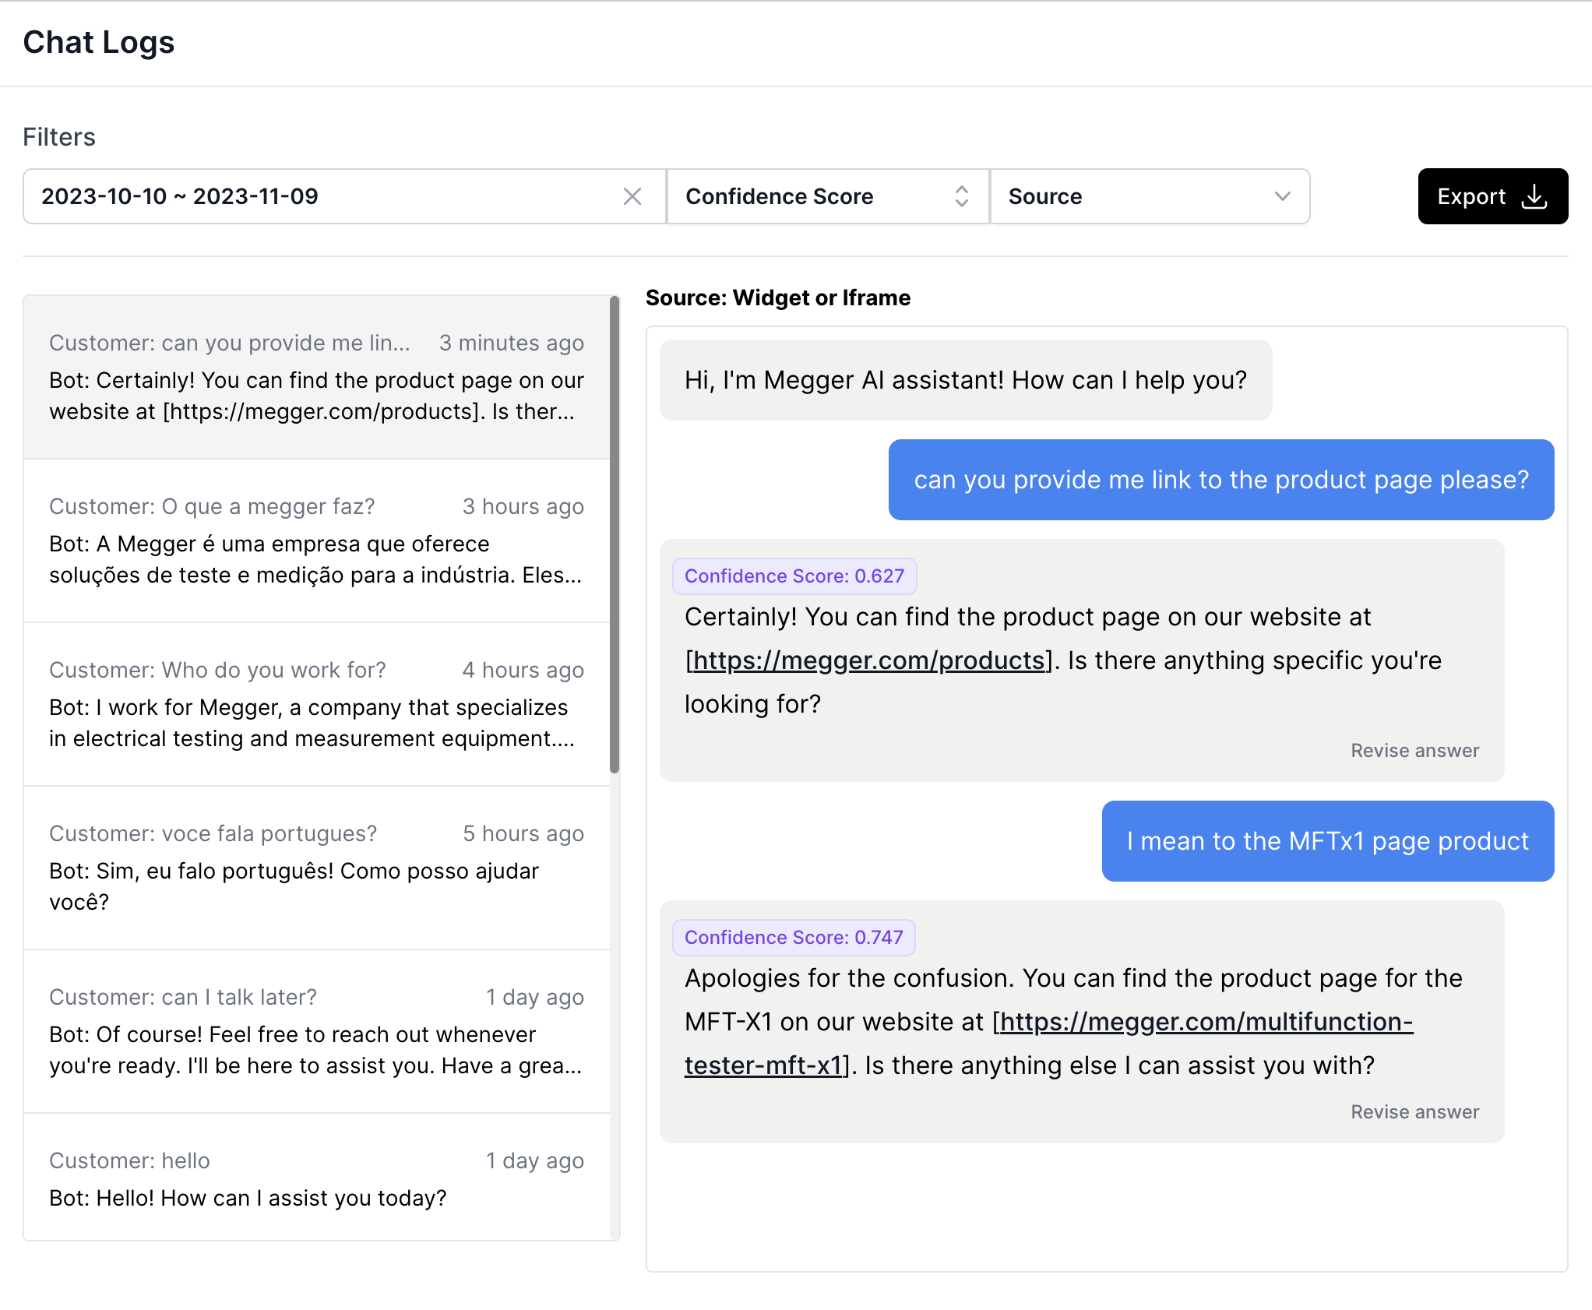
Leveraging Chatbot Analytics for PPC Optimization
Detailed insights into user questions and behaviour, providing valuable data for campaign optimization
Identifying common concerns or interests that can inform ad copy and keyword strategy
Understanding what really the customer is typing to find what they wants

Slide 5
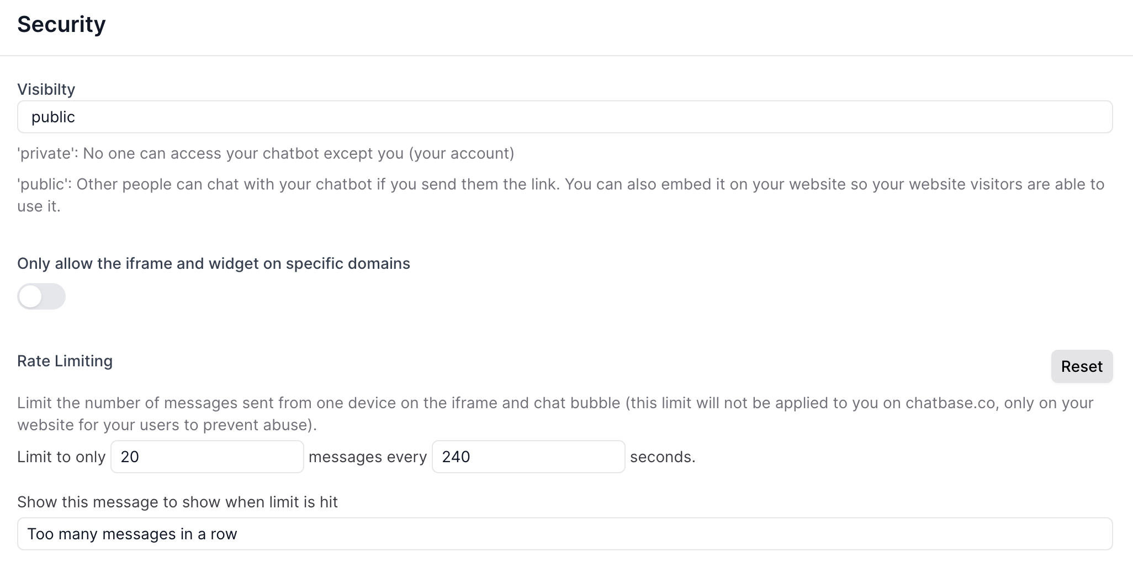
Monitoring and Security
Monitoring chatbot through Chat Logs interactions to refine the user experience and conversion path continuously
GDPR compliant, chat completely secure, no open source

Slide 6
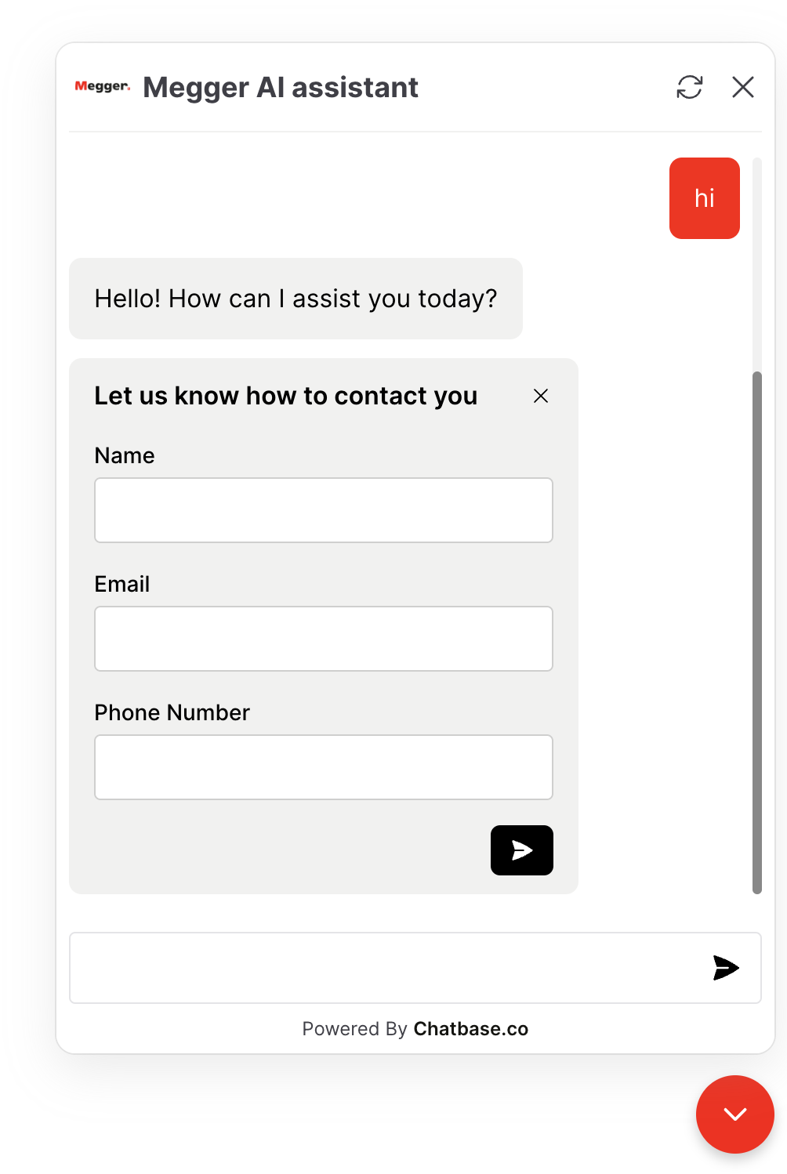
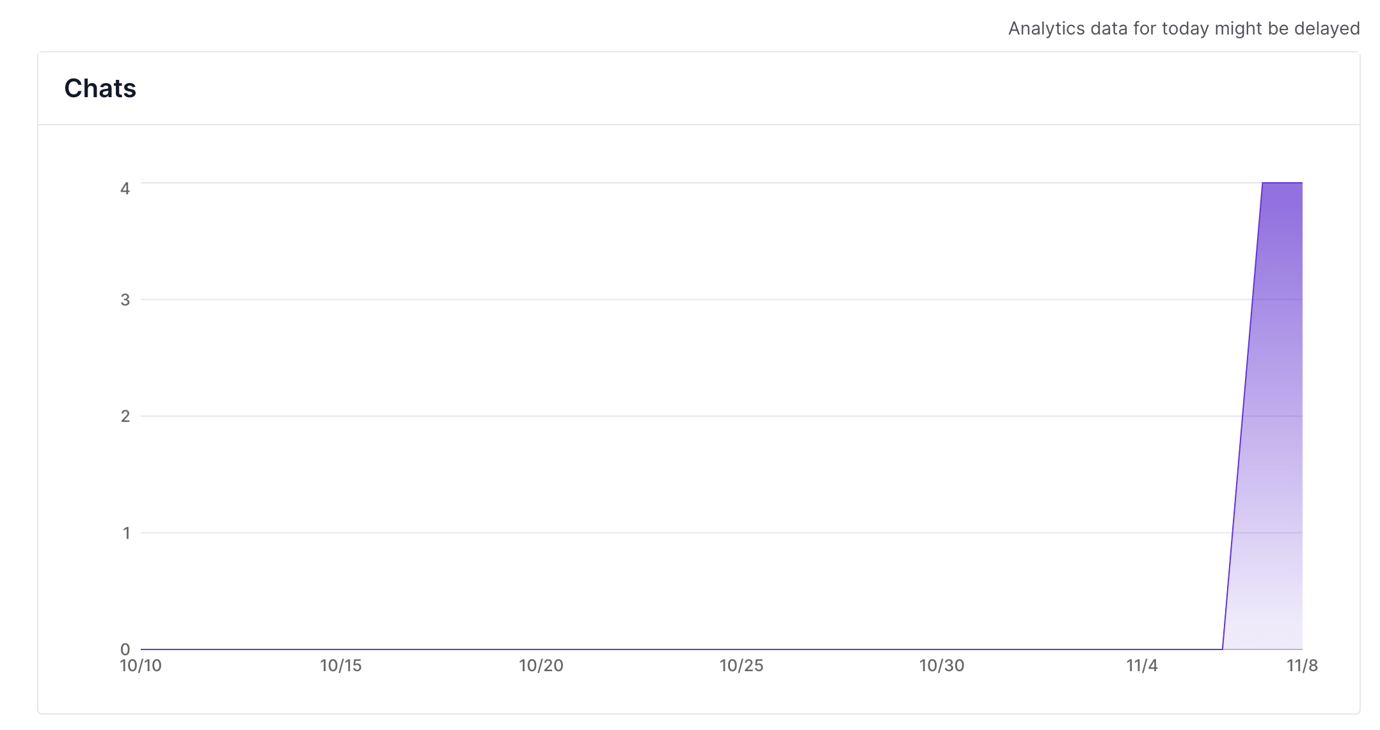
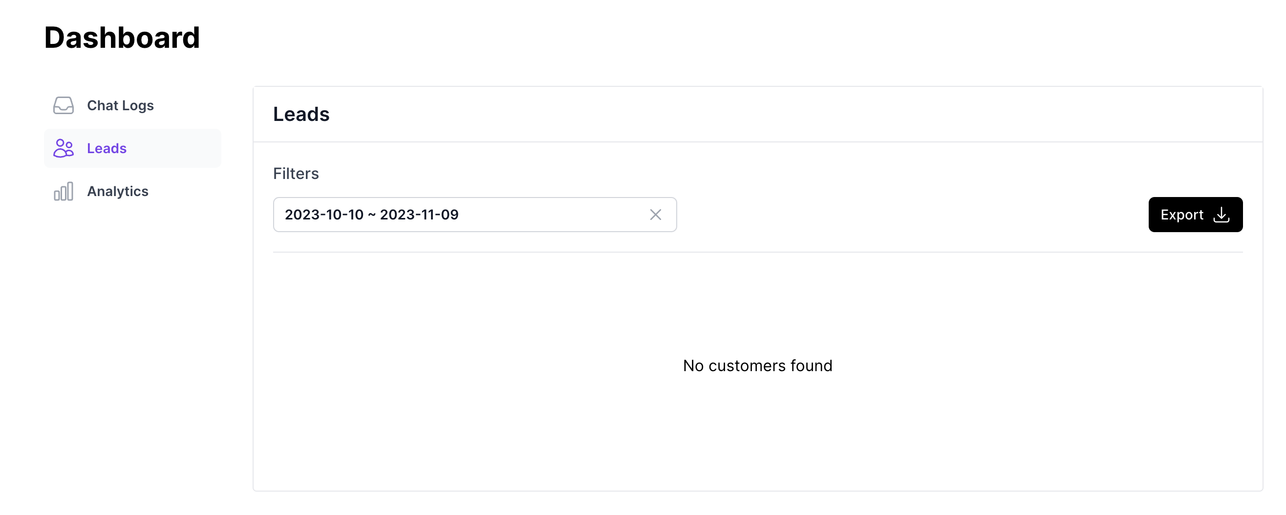
Lead Generation, Analytics & Insights
Name, email and Phone can be exported as leads
Chatbot Analytics & Insights

Slide 7

Case Study: Chatbot on MFTX1 microsite
https://mftx1-chatgpt-bot.webflow.io/

Slide 8
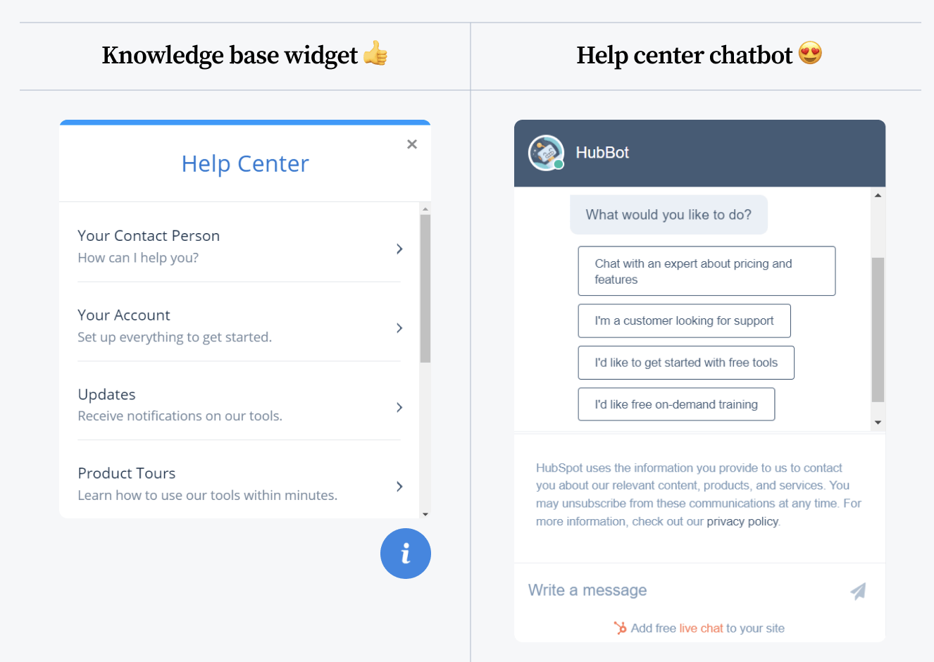
Other uses…
Knowledge center helper
Links to recourses
Courses, Megger Certifications
Serve as a digital librarian helping to gather webinars, datasheets, application notes
Resources that contain the key phrase / query / information
Further reading and information for the customer
Conversational
Engaging

Slide 9
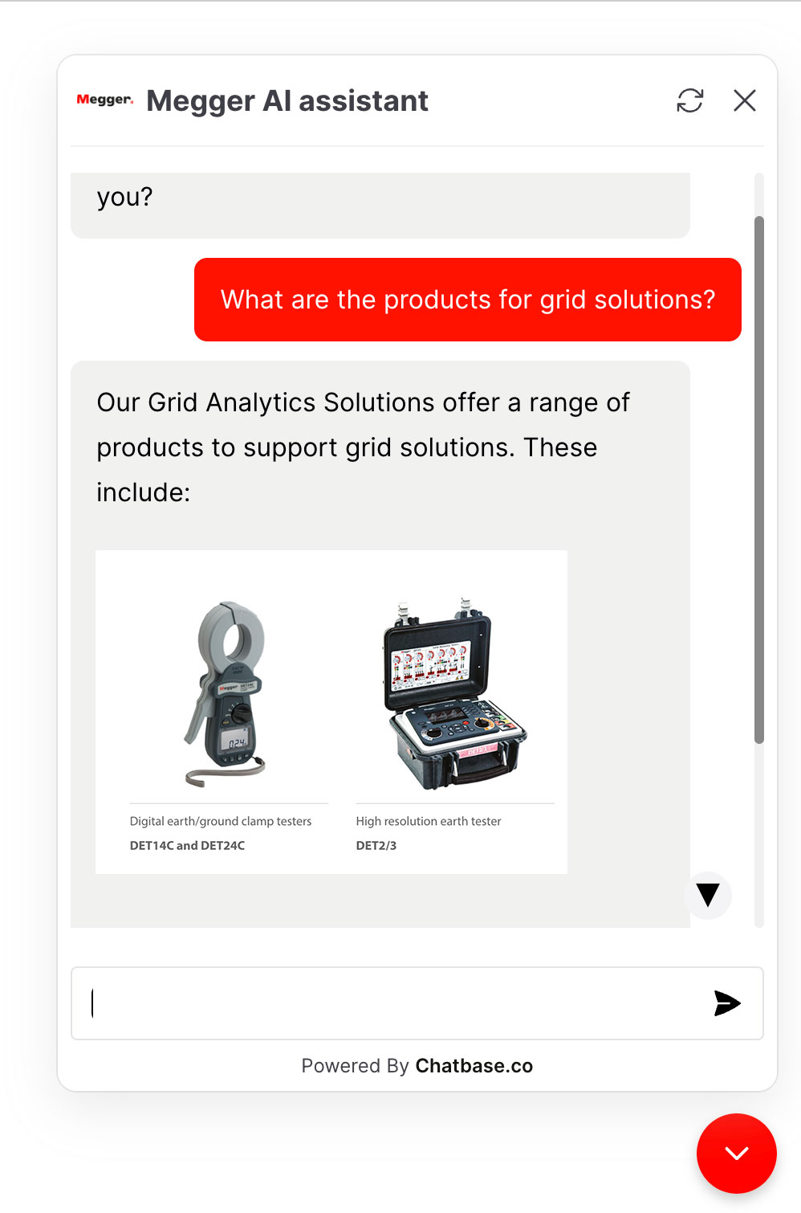
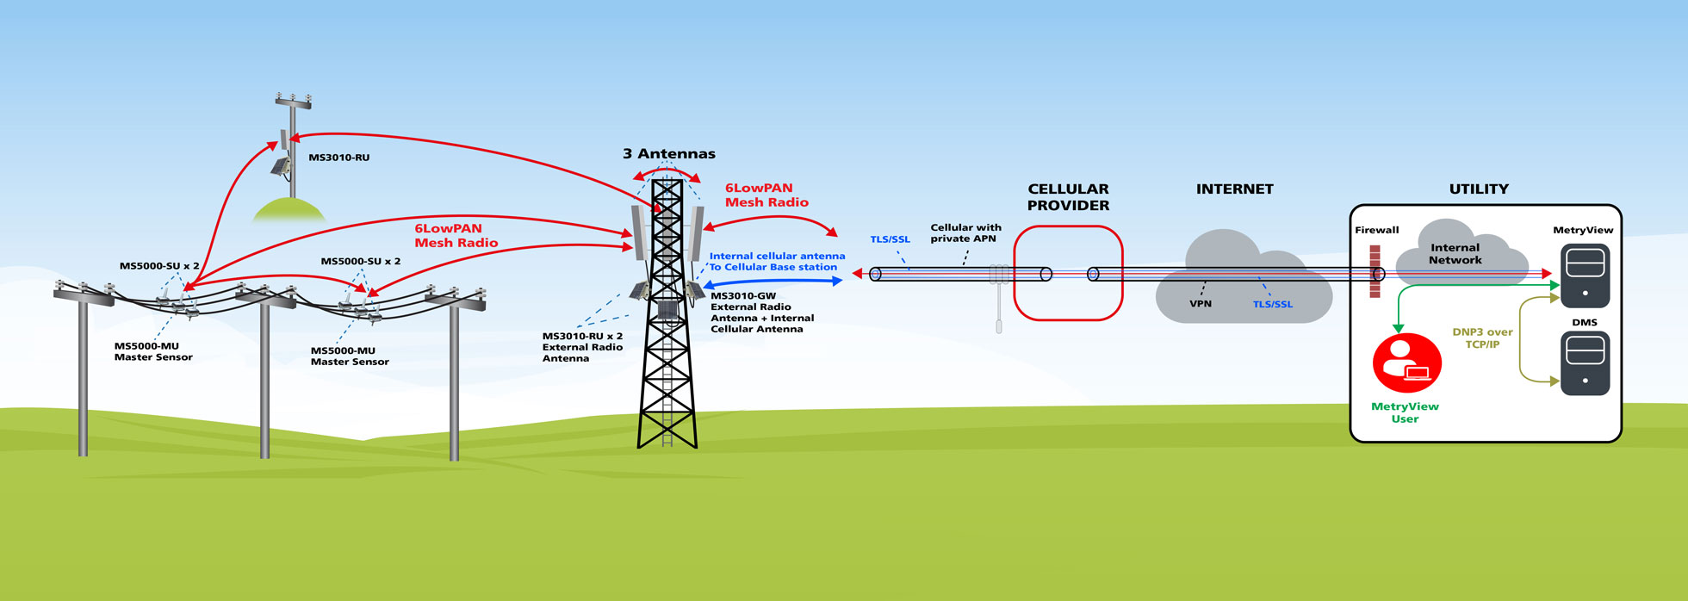
Other uses…
Grid Solutions explained
Difficult technologies to explain

